Slide 1
Crime Rate Prediction & Analysis using K-Means Clustering Algorithm
GUIDED BY,
NAME:LYNNET ALICE EZRA
DESIGNATION: ASSISTANT PROFESSOR
COLLEGE:WESLEY PG COLEGE
PRESENTED BY,
MANDAPURI VAMSHIKRISHNA
HALL TICKET:1251-21-862-026

Slide 2
ABSTRACT
In India, the crime rate is increasing each day. In the current situation, recent technological influence, effects of social media and modern approaches help the offenders to achieve their crimes. Both analysis and prediction of crime is a systematized method that classifies and examines the crime patterns. There exist various clustering algorithms for crime analysis and pattern prediction but they do not reveal all the requirements. Among these, K means algorithm provides a better way for predicting the results. The proposed research work mainly focused on predicting the region with higher crime rates and age groups with more or less criminal tendencies. We propose an optimized K means algorithm to lower the time complexity and improve efficiency in the result.

Slide 3
INTRODUCTION
In present scenario criminals are becoming technologically sophisticated in committing crime and one challenge faced by intelligence and law enforcement agencies is difficulty in analyzing large volume of data involved in crime and terrorist activities therefore agencies need to know technique to catch criminal and remain ahead in the eternal race between the criminals and the law enforcement. So appropriate field need to chosen to perform crime analysis and as data mining refers to extracting or mining knowledge from large amounts of data, data mining is used here on high volume crime dataset and knowledge gained from data mining approaches is useful and support police forces. To perform crime analysis appropriate data mining approach need to be chosen and as clustering is an approach of data mining which groups a set of objects in such a way that object in the same group are more similar than those in other groups and involved various algorithms that differ significantly in their notion of what constitutes a cluster and how to efficiently find them. In this paper k means clustering technique of data mining used to extract useful information from the high volume crime dataset and to interpret the data which assist police in identify and analyze crime patterns to reduce further occurrences of similar incidence and provide information to reduce the crime.

Slide 4
EXISTING SYSTEM
Crime analysis tool is developed using various distinct data mining methods. It supports the police officers for investigating crimes [6]. Implementing a clustering algorithm on crime datasets enables analysis of crimes [7]. It makes identification and analysis of various criminality trends over the years through their conclusion. The random initial starting points produced by K-means which gives results in the form of cluster that helps in reaching the local optima [8]. So to overcome this problem, the partitioned data along with the data axis with the highest variance for assigning the initial centroid for K-Means clustering was applied. So it is observed that the proposed technique uses a lesser number of iteration thereby reducing the clustering time. Using merge sort, K-means algorithm can be improved for clustering the Hidden Markov Model.

Slide 5
Proposed System
We are working on Spyder for implementation. Here we use a Spyder 3.7 version. Spyder is an integrated development environment for systematic programming in Python. Here we implemented different packages like matplotlib ,numpy ,sklearn , pandas,etc. Which helps to plot elbow graph and data frame table using a K-means clustering algorithm? Dataset is collected from Kaggle datasets and import datasets into Spyder in CSV format as shown in Fig 1. We perform normalization for finding the accurate number of clusters (k) using the elbow method. The elbow method performs k- means clustering on the obtained dataset for a range of values of k (2-15) and calculates the SSE. A line chart of the SSE is plotted for each value of k.

Slide 6
Software Requirements Specifications
Hardware requirement
Memory - 8GB RAM
Intel I5 Core Processor
Hard Disk : 250 Gb
Software requirement
Operating System: windows, linux
Python idel 3.7 version or Anaconda 3.7 or Google colab

Slide 7
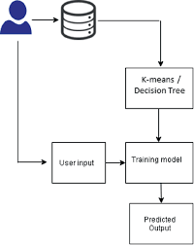
ARCHITECTURE DIAGRAM

Slide 8
USE CASE DIAGRAM

Slide 9
CLASS DIAGRAM

Slide 10
SEQUENCE DIAGRAM

Slide 11
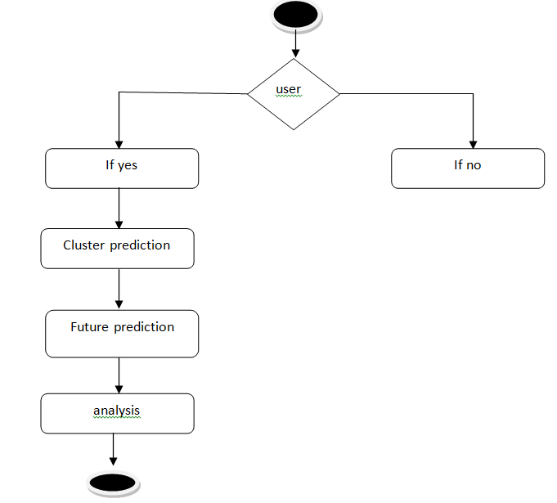
ACTIVITY DIAGRAM

Slide 12
TESTING
Software integration testing is the incremental integration testing of two or more integrated software components on a single platform to produce failures caused by interface defects.
The task of the integration test is to check that components or software applications, e.g. components in a software system or – one step up – software applications at the company level – interact without error.
Test Results: All the test cases mentioned above passed successfully. No defects encountered.
Acceptance Testing
User Acceptance Testing is a critical phase of any project and requires significant participation by the end user. It also ensures that the system meets the functional requirements.
Test Results: All the test cases mentioned above passed successfully. No defects encountered.

Slide 13
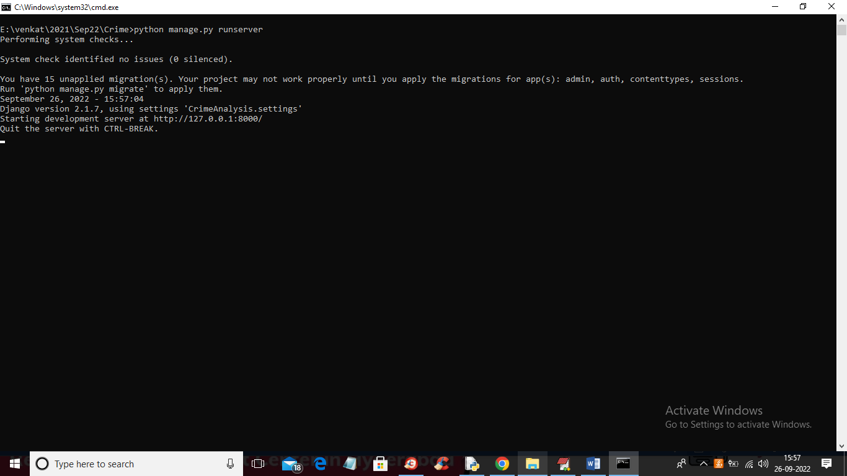
OUTPUT SCREENS

Slide 14
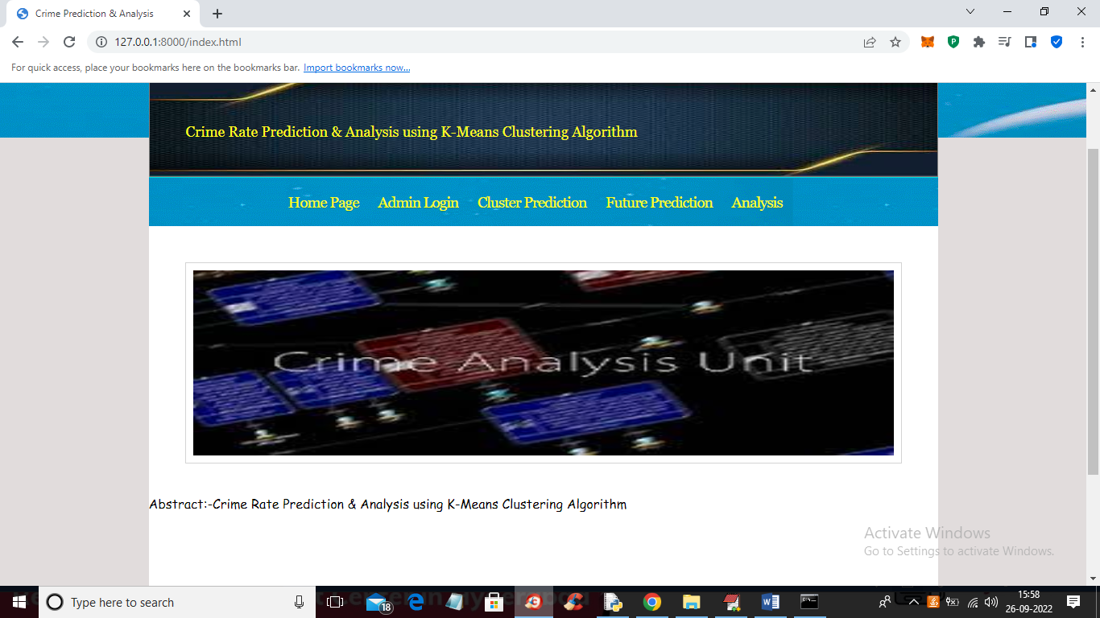
OUTPUT SCREENS

Slide 15
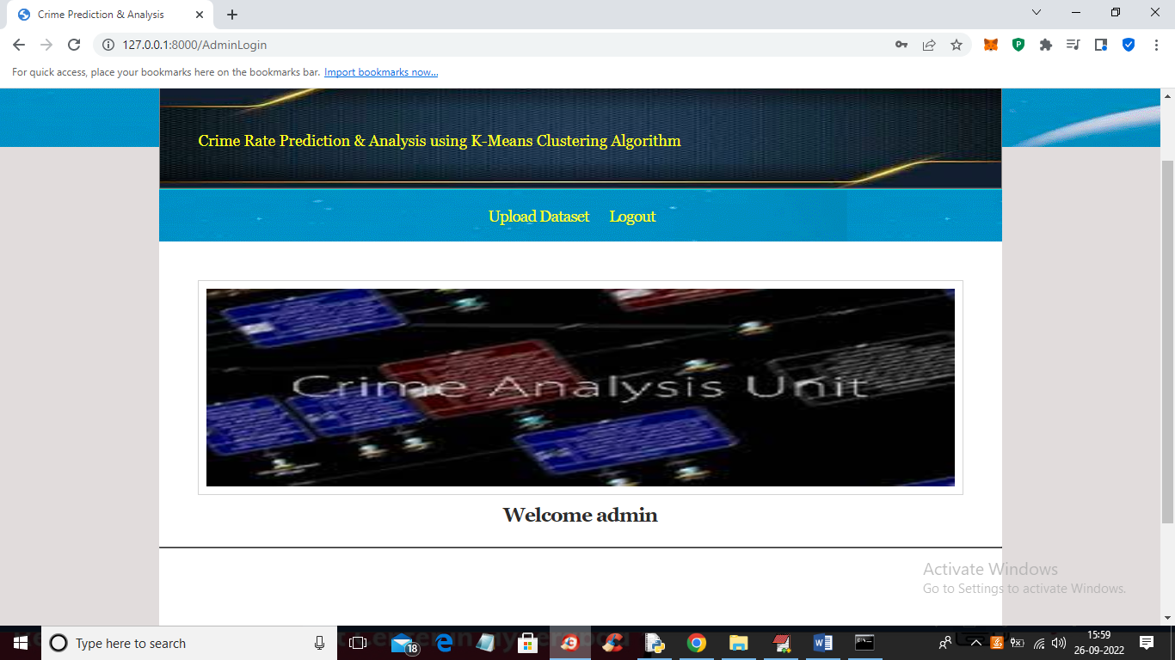
OUTPUT SCREENS

Slide 16
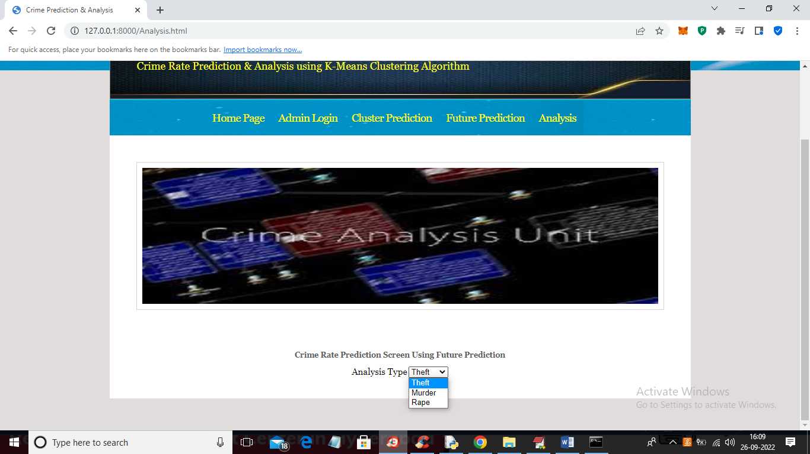
OUTPUT SCREENS

Slide 17
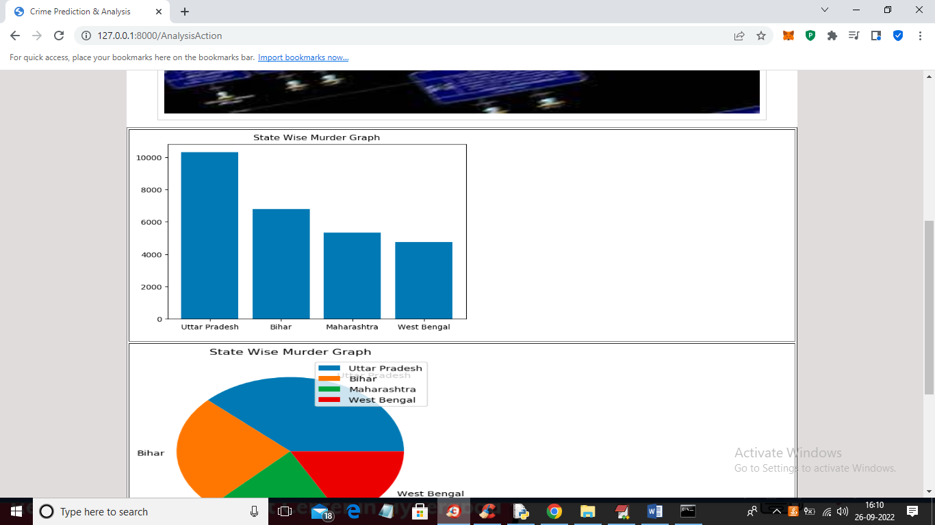
OUTPUT SCREENS

Slide 18
CONCLUSION
This project focuses on crime analysis by implementing clustering algorithm on crime dataset using rapid miner tool and here we do crime analysis by considering crime homicide and plotting it with respect to year and got into conclusion that homicide is decreasing from 1990 to 2011 .From the clustered results it is easy to identify crime trend over years and can be used to design precaution methods for future.
FUTURE SCOPE :
From the encouraging results, we believe that crime data mining has a promising future for increasin the effectiveness and efficiency of criminal and intelligence analysis. Visual and intuitive criminal and intelligence investigation techniques can be developed for crime pattern. As we have applied clustering technique of data mining for crime analysis we can also perform other techniques of data mining such as classification. Also we can perform analysis on various dataset such as enterprise survey dataset, poverty dataset, aid effectiveness dataset, etc.

Slide 19
REFERENCES
[1] De Bruin ,J.S.,Cocx,T.K,Kosters,W.A.,Laros,J. and Kok,J.N(2006) Data mining approaches to criminal carrer analysis ,”in Proceedings of the Sixth International Conference on Data Mining (ICDM”06) ,Pp. 171-177
[2] Manish Gupta1*, B.Chandra1 and M. P. Gupta1,2007 Crime Data Mining for Indian Police Information System
[3] Nazlena Mohamad Ali1, Masnizah Mohd2, Hyowon Lee3, Alan F. Smeaton3, Fabio Crestani4 and Shahrul Azman Mohd Noah2 ,2010 Visual Interactive Malaysia Crime News Retrieval System
[4] Sutapat Thirprungsri Rutgers University .USA ,2011 Cluster Analysis of Anomaly Detection in Accounting Data : An Audit Approach 1
[5] A.Malathi ,Dr.S.Santhosh Baboo. D.G. Vaishnav College,Chennai ,2011 Algorithmic Crime Prediction Model Based on the Analysis of Crime Clusters.
[6] Malathi.A 1 ,Dr.S.Santhosh Baboo 2 and Anbarasi . A 31 Assistant professor ,Department of Computer Science ,Govt Arts College ,Coimbatore , India . 2 Readers , Department of Computer science , D.G. Vaishnav Collge ,Chennai , India , 2011 An intelligent Analysis of a city Crime Data Using Data Mining
[7] Malathi , A; Santhosh Baboo , S, 2011 An Enhanced Algorithm to Predict a Future Crime using Data Mining
[8] Kadhim B.Swadi al-Janabi . Department of Computer Science . Faculty of Mathematics and Computer Science .University of Kufa/Iraq , 2011 A Proposed Framework for Analyzing Crime DataSet using Decision Tree and Simple K-means Mining Algorithms.
[9] Aravindan Mahendiran, Michael Shuffett, Sathappan Muthiah, Rimy Malla, Gaoqiang Zhang,2011 Forecasting Crime Incidents using Cluster Analysis and Bayesian Belief Networks

Slide 20
THANK YOU

